Slide 1
PROBLEM STATEMENT
Army database management system” is used to store the information of soldiers. It is very difficult to store all the records of all the soldiers in a paper. Hence this Army Management System contains a database consisting of Personal information, Family information, Address information, Training information, Regiment information, Weapons and Award details of the soldiers. Admin can login using his/her username and password. He/She can get the information of soldiers and can also update the details.

Slide 2
ABSTRACT
Army database management system is database project to store the details of soldiers. For the ease of access it is divided into many categories such as regiment, training, personal, awards, weapon and family. Database also provides insertion, deletion and the update options for both Soldiers and family members. Our database also provides with the view option where entire details can be retrieved using id. It also supports various views such as achievements, family background, and regiment detail.

Slide 3
OBJECTIVES
To provide details of all soldiers.
To provide details of all regiments.
To provide information about the Army and its hierarchy.
To update the records in the existing table to reflect changes in the original table.
To delete the information of Ex-serviceman.

Slide 4
REQUIREMENT SPECIFIACTIONS
Operating system - Windows
Backend - MySQL
Front end - Java swings
Platform - JDBC jar

Slide 5
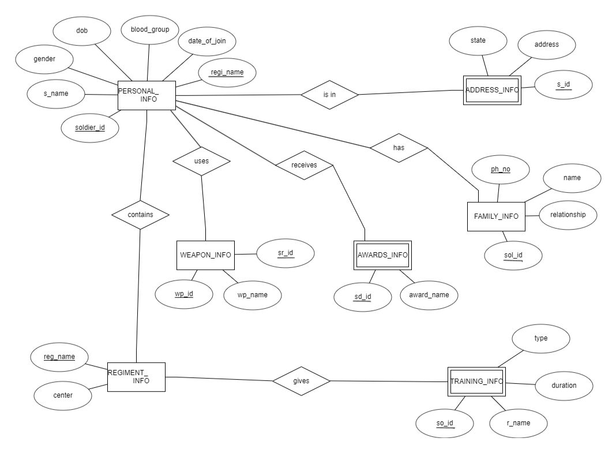
ER DIAGRAM

Slide 6
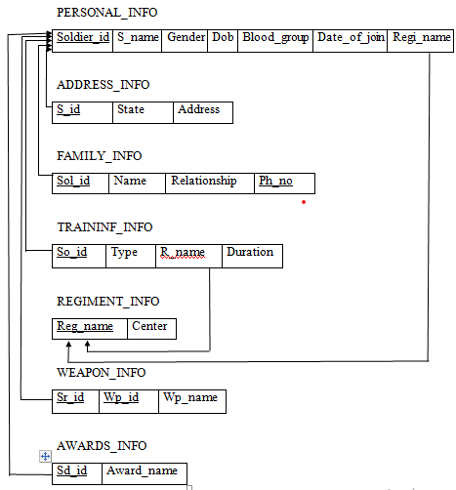
SCHEMA DIAGRAM

Slide 7
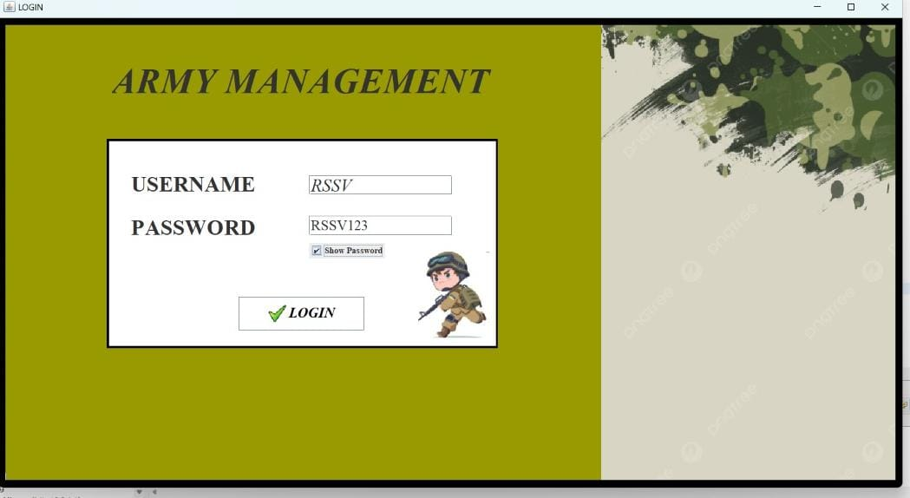
FRONT TABLES

Slide 8
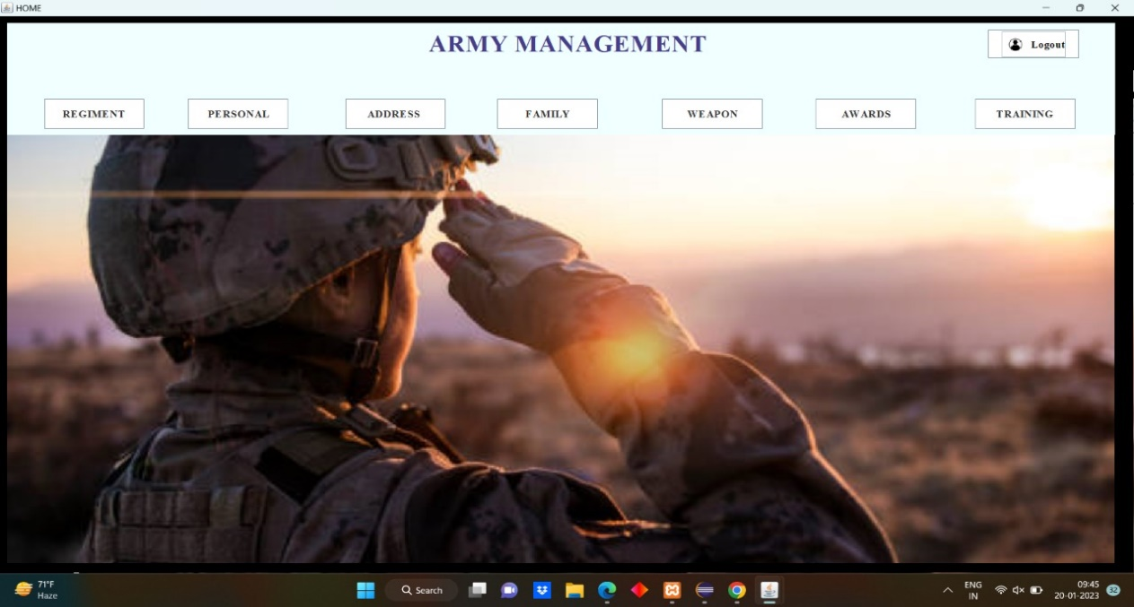

Slide 9
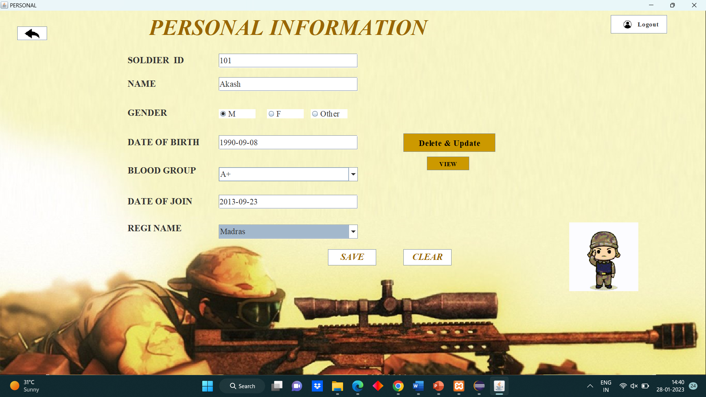

Slide 10
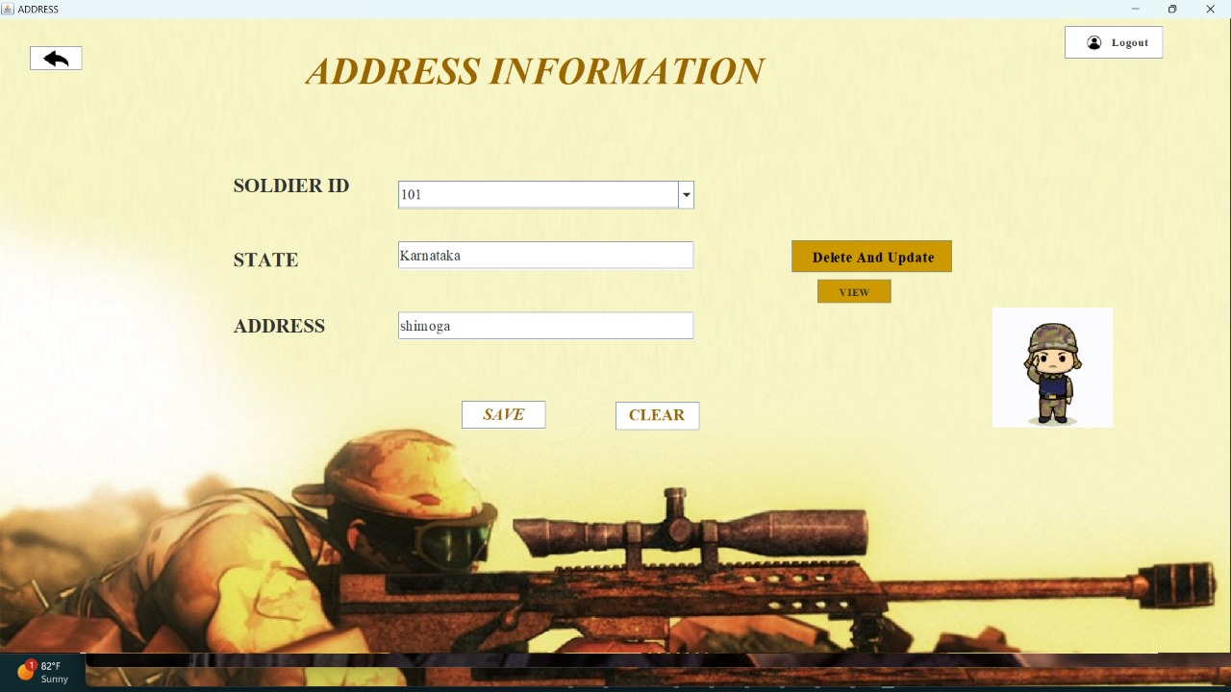

Slide 11
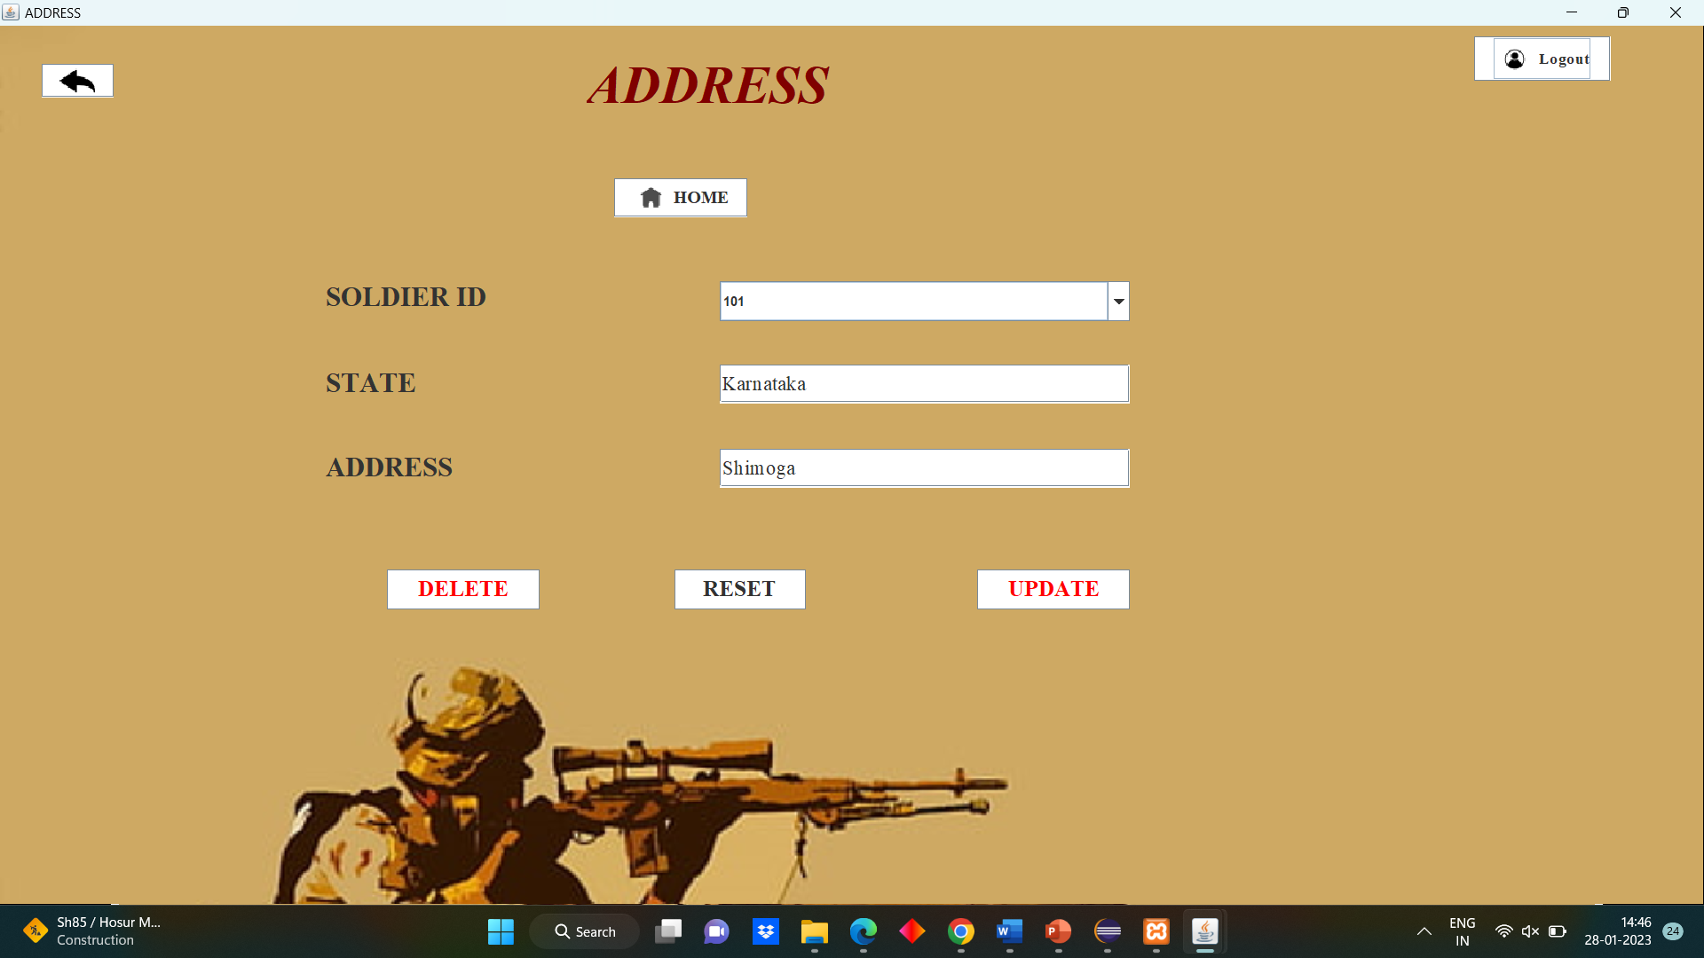

Slide 12
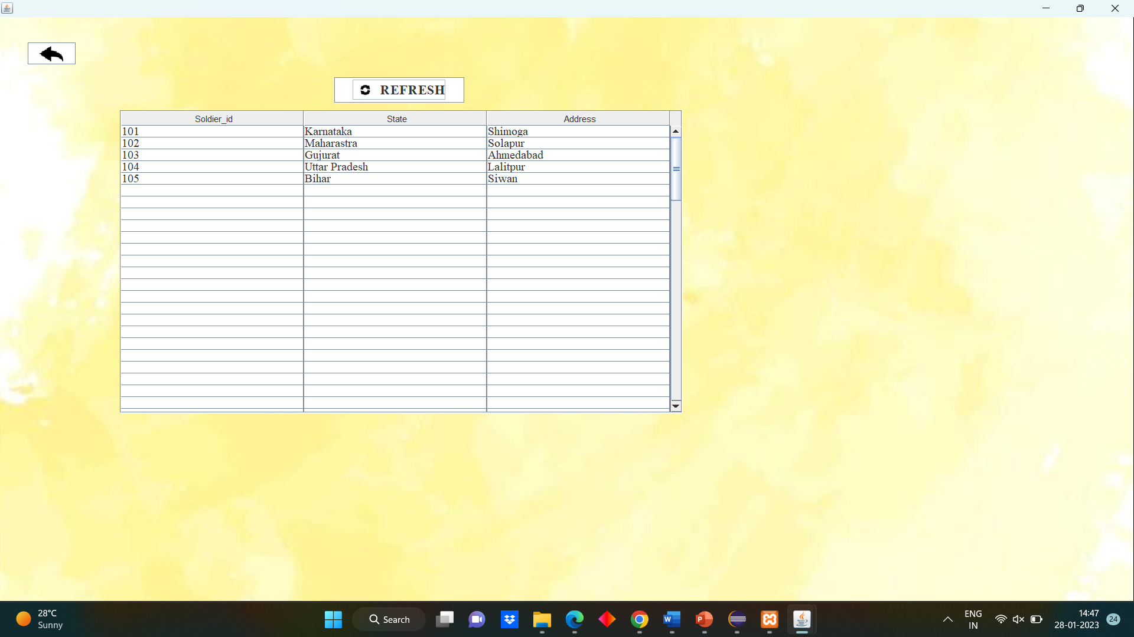

Slide 13
CONCLUSION
Database management system can be used to access the information of all the soldiers. Information can be updated by authorized person in order to give security to the system.
Intelligence report uses database during war and internal threats. Jobs can be easily divided. In future it can be universalized for every category of all types of security services.

Slide 14
FUTURE SCOPE
The future scope of this project ARMY MANAGEMENT SYSTEM is very wide. There are many additional features, which are planned to be incorporated during the future enhancements of this project. The Future version of System there is some point that we may implement on them:
Salary updation can be done.
Marriage status can be added.
It can be implemented as mobile application also.

Slide 15
REFERENCES
Ramez Elmasri and Shamkant B. Navathe, “Database systems Models, Languages, Design and Application Programming”, Pearson, 7th Edition, 2017.
Raghu Ramakrishnan, and Gehrke, “Database management systems”, McGraw Hill, 3rd Edition, 2014.
Herbert Schildt: JAVA the Complete Reference, 7th/9th Edition, Tata McGraw Hill, 2007.
Jim Keogh: J2EE-TheCompleteReference, McGraw Hill, 2007.

